Slide 1
Scikit Learn
Usability Test: Cognitive Walkthrough

Slide 2
Persona
Mikey J
New employee at a database driven company trying to create a new training setup for new hires and interns.
Would not understand next actions very well in terms of training formatting
Needs very dense instruction set to run, showing various scenarios and options.

Slide 3
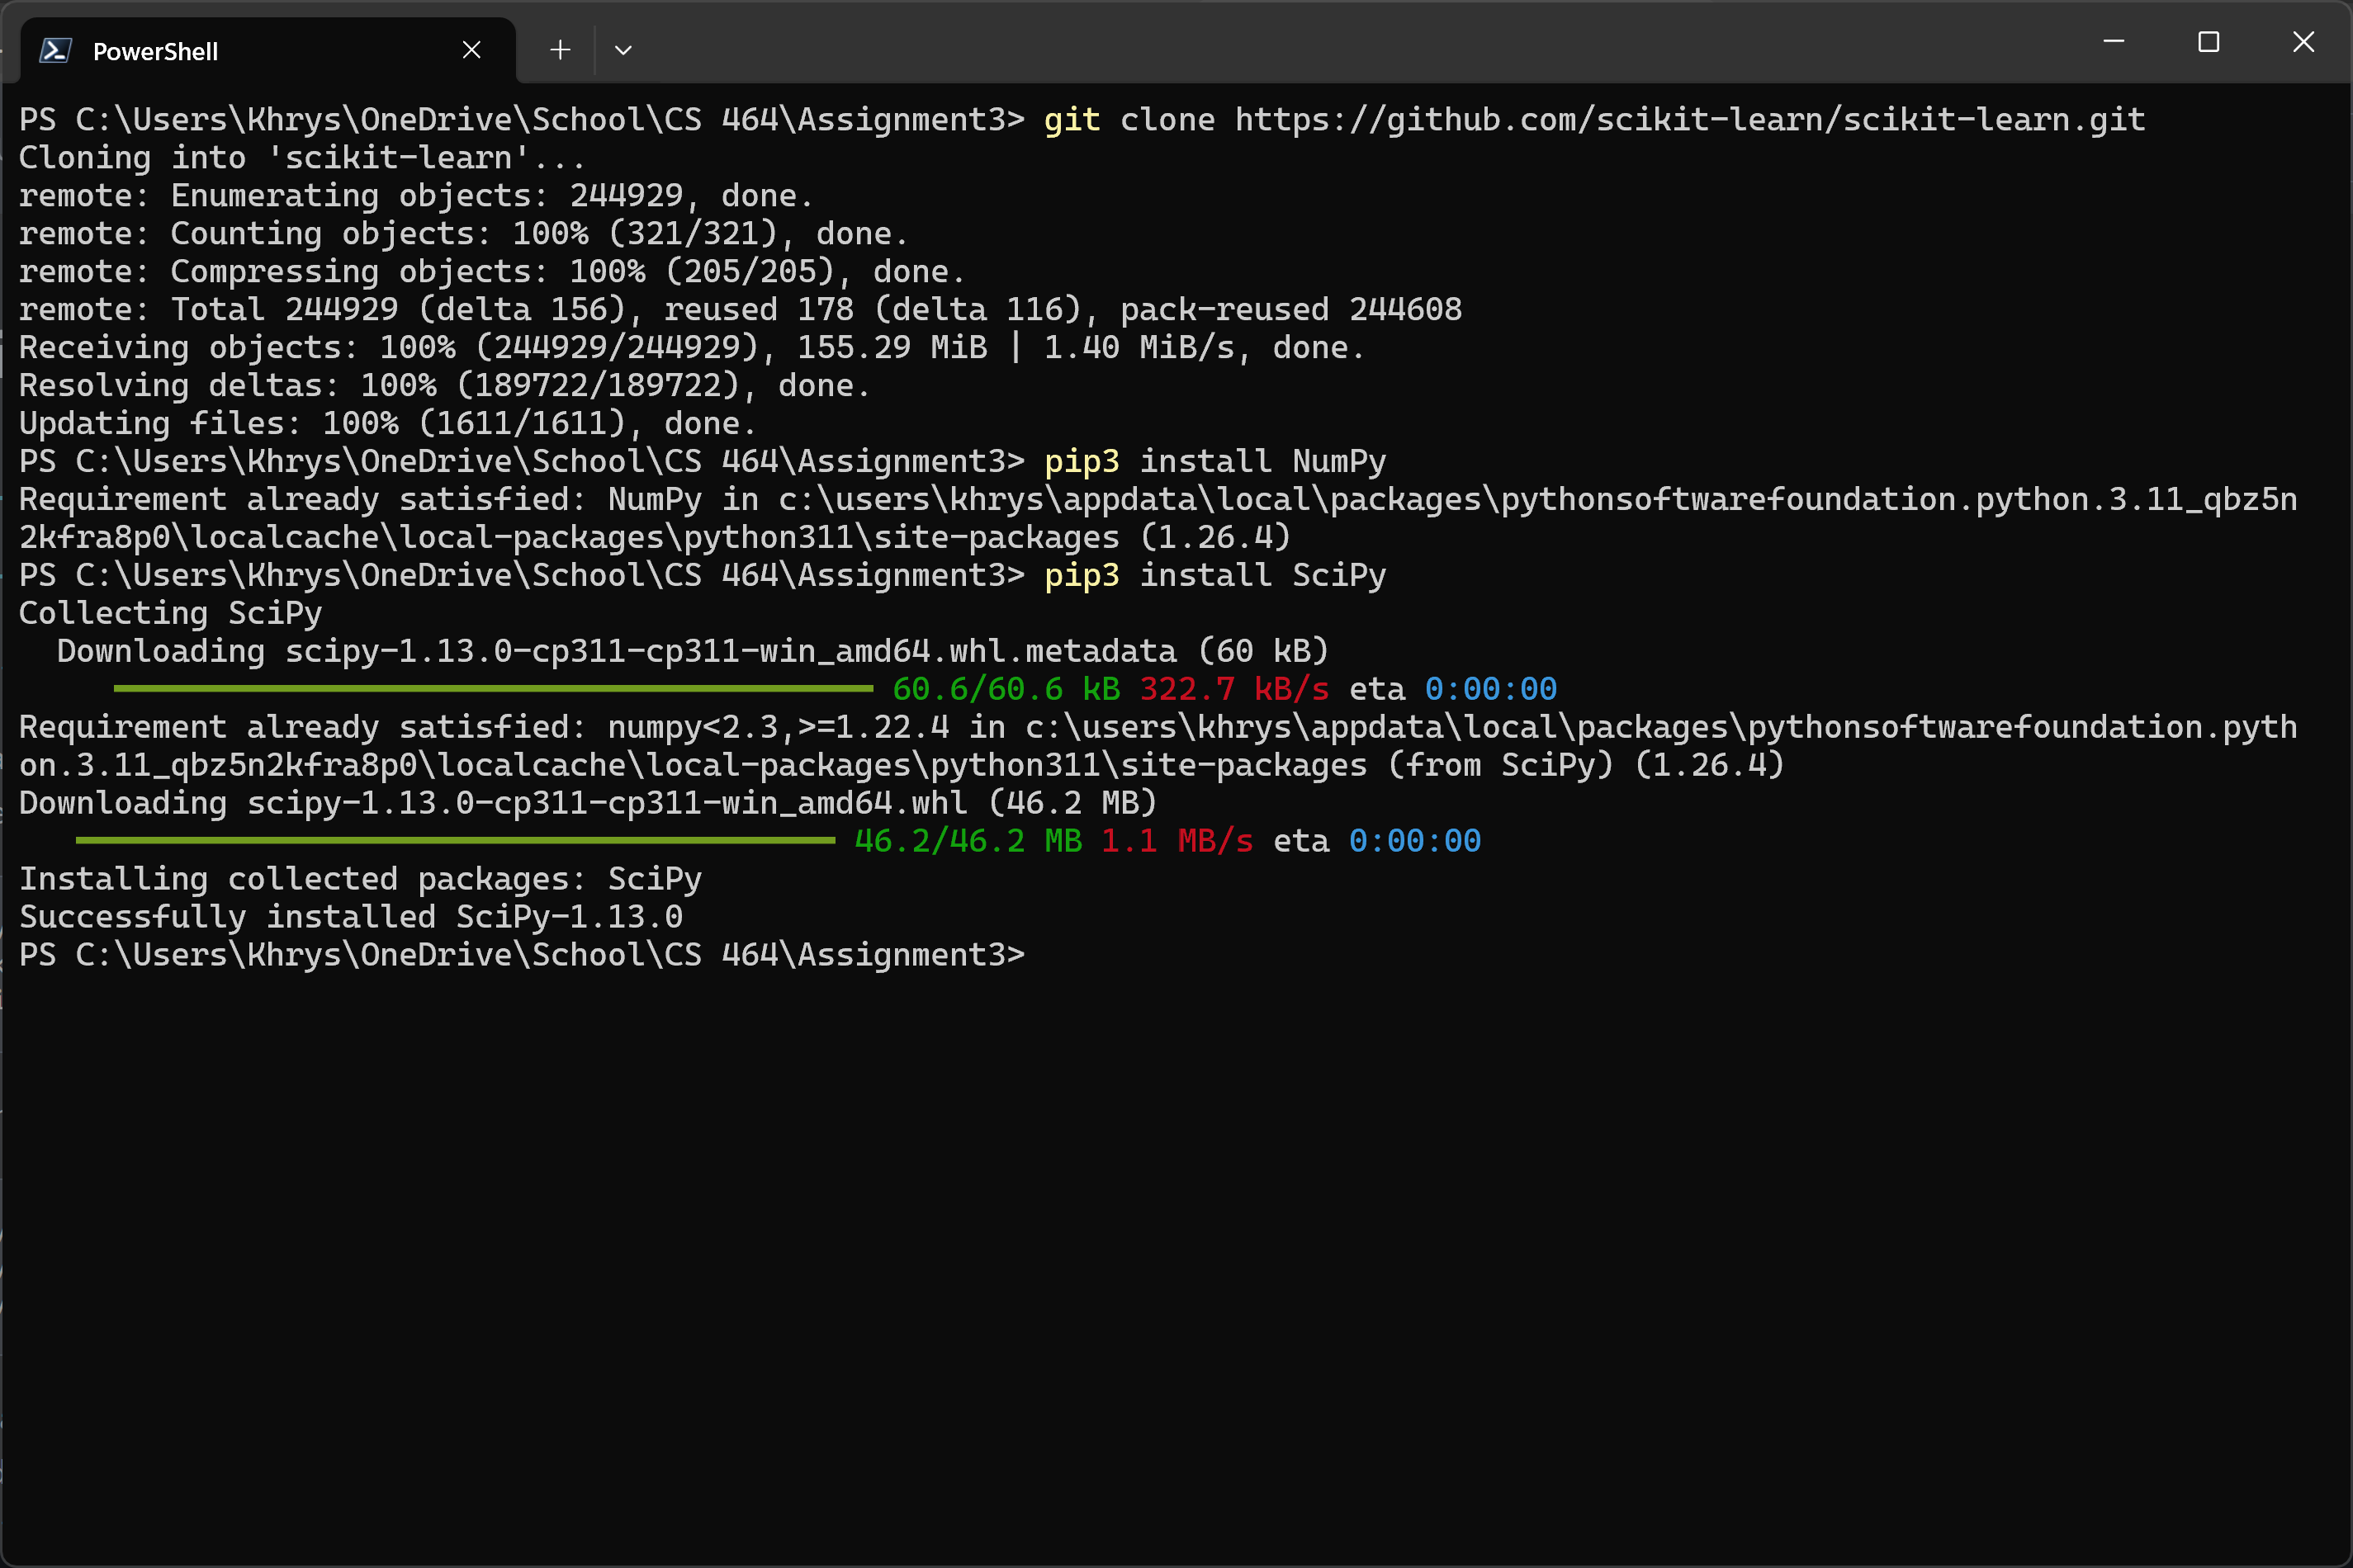
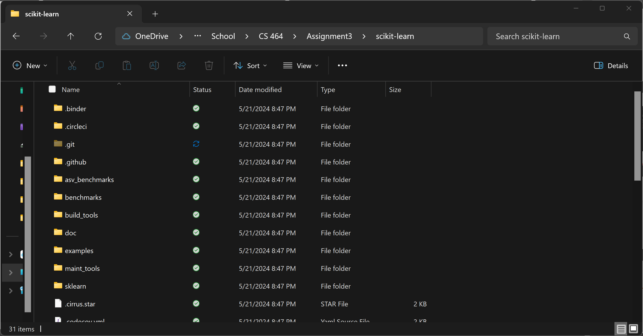
Preparation
Setup the environment
Clone the repository
Review documentation
Notes:
Commands: Check to ensure memory available. OS is up to date. Cloned the repo (Command in screenshot). Review documentation (reviewed to ensure it is was cloned without issues).
Notes: This portion of the process was very simple and easily laid out in the directions. Very easy to follow and clear on what the criteria for is. The cloned repository took a lot of time and space. NumPy and SciPy are pretty small items to verify and/or download.

Slide 4
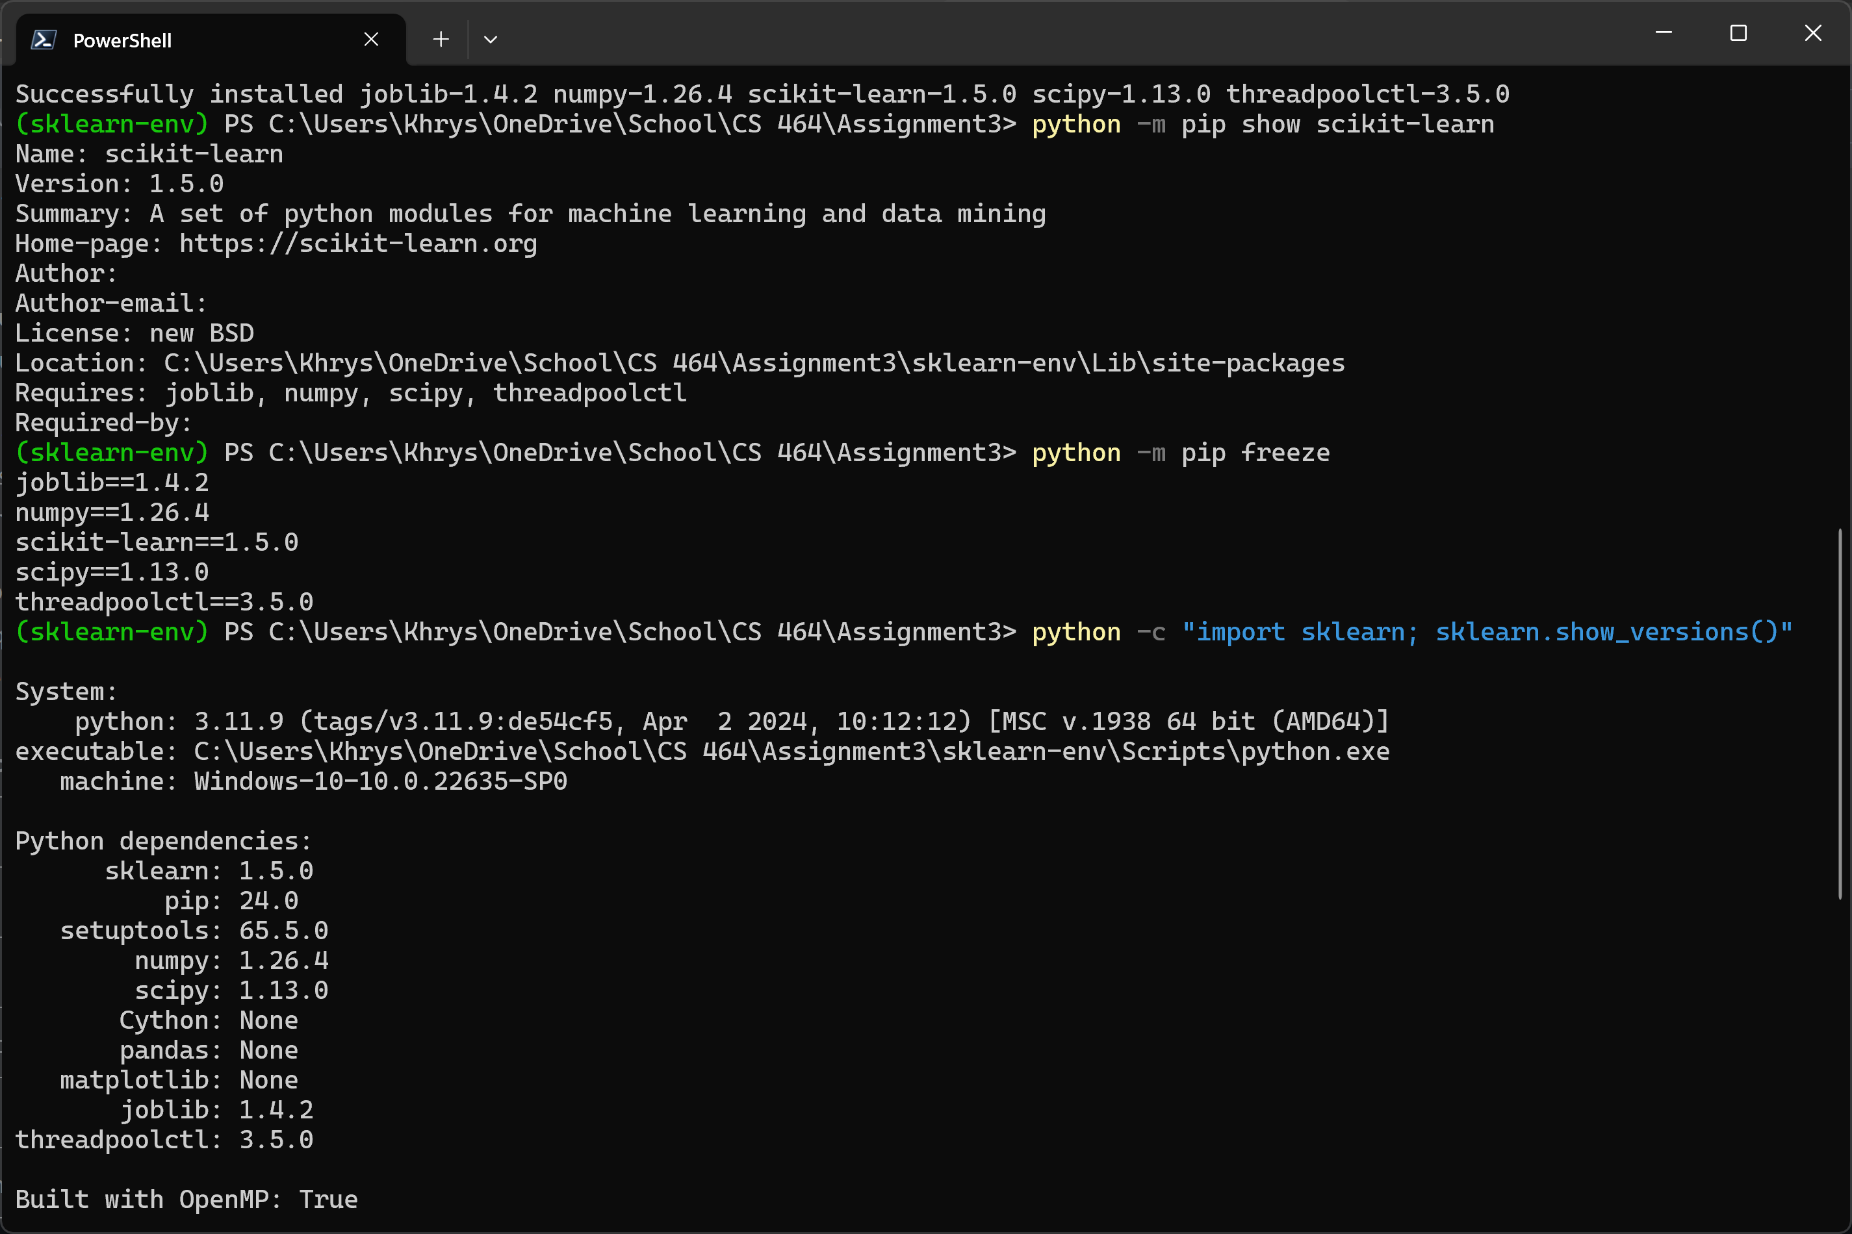
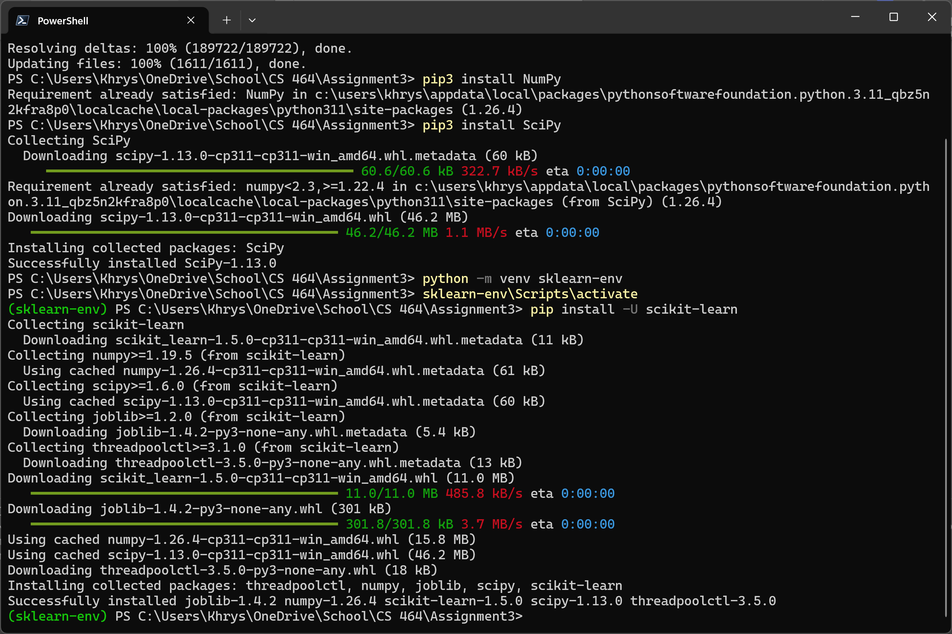
Installation
Commands:
python -m venv sklearn-env
sklearn-env\Scripts\activate # activate
pip install -U scikit-learn
python -m pip show scikit-learn # show scikit-learn version and location
python -m pip freeze # show all installed packages in the environment
python -c "import sklearn; sklearn.show_versions()"
Notes:
Commands: Create the virtual environment, enter the venv. Verify the install version, location and environment.
Notes: Initially I believed the tiny snippet on the main git page was way too short for installation instructions but with the follow-on link to the webpage containing in-depth steps, was very helpful.
In following the commands the project overall takes less than 5 minutes to install. They also have verification steps as well as easy to access options for installs on other OS’s.

Slide 5

Findings
Very easy to install
Steps were simple
Only thing I would add are more dense information on what each step is doing and or downloading.
A lot of troubleshooting steps are included but never needed as the install went extremely smoothly.

